Slide 1
Experimentelle Option – Jetzt und Zukunft
1
Bestehendes Program sinnvoll erweitern:
Konzentrationen: CO₂ CH_{4,}
Fokus auf Anaerobie
Fe und DOC release
Metabolismus (CO2 Anstieg, Vergleich zur Oberfläche)
DOC “Qualität” (Farbe/Abbaubarkeit, Zusammensetzung)
Mögliche Zusatz-”Module”
Foodweb, Methanoxidation, Metabolismus, …
2
3

Slide 2
1 Logger an der Oberfläche
Alle 11
2 Logger im Tiefenwasser:
Tegeler See
Breiter Luzin
Schmaler Luzin
Laacher See
Scharmützelsee
Titisee
Arendsee
Weitere mögliche IGB Standorte
Fuchskuhle
Stechlin
Müggelsee
1 Logger im Tiefenwasser:
Groß Glienicker
Haussee
Ilmensee
Peetzsee
episodes of very low oxygen (<1mg/L)

Slide 3
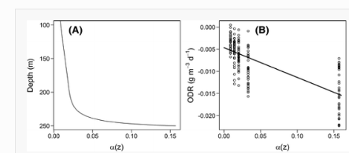
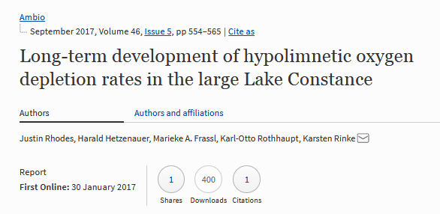
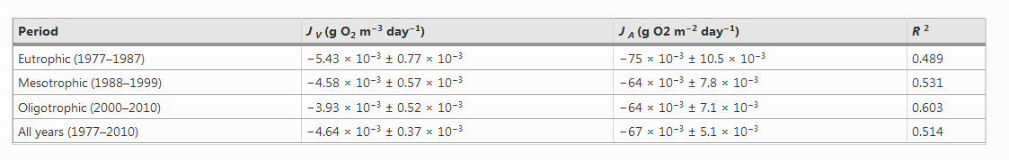
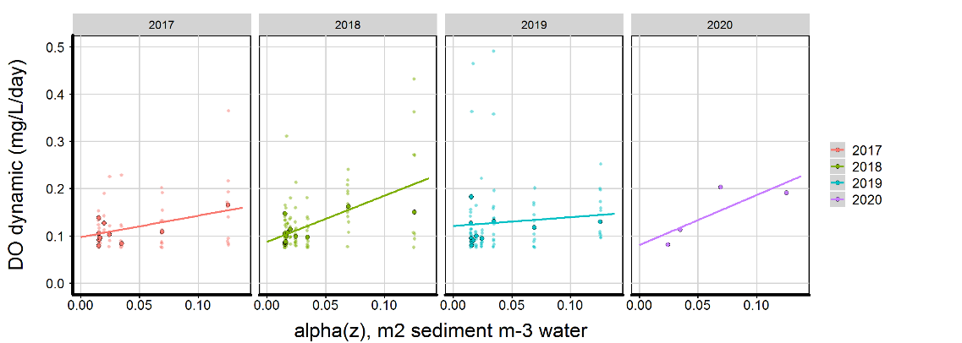
O₂ Zehrungsraten aus kontinuierlichen Messdaten
Arendsee

Slide 4
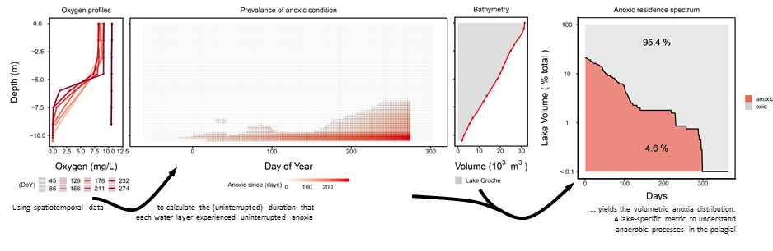
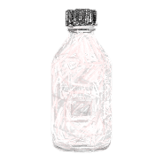
study time dependent processes
…that start when oxygen is gone
1 Profile Sampling =
t_{a} anoxic age
_{Metric for each sample}
Anoxic age spectrum
Metric for a lake for a given holomixis period (≈year)
x Incubations of different length

Slide 5
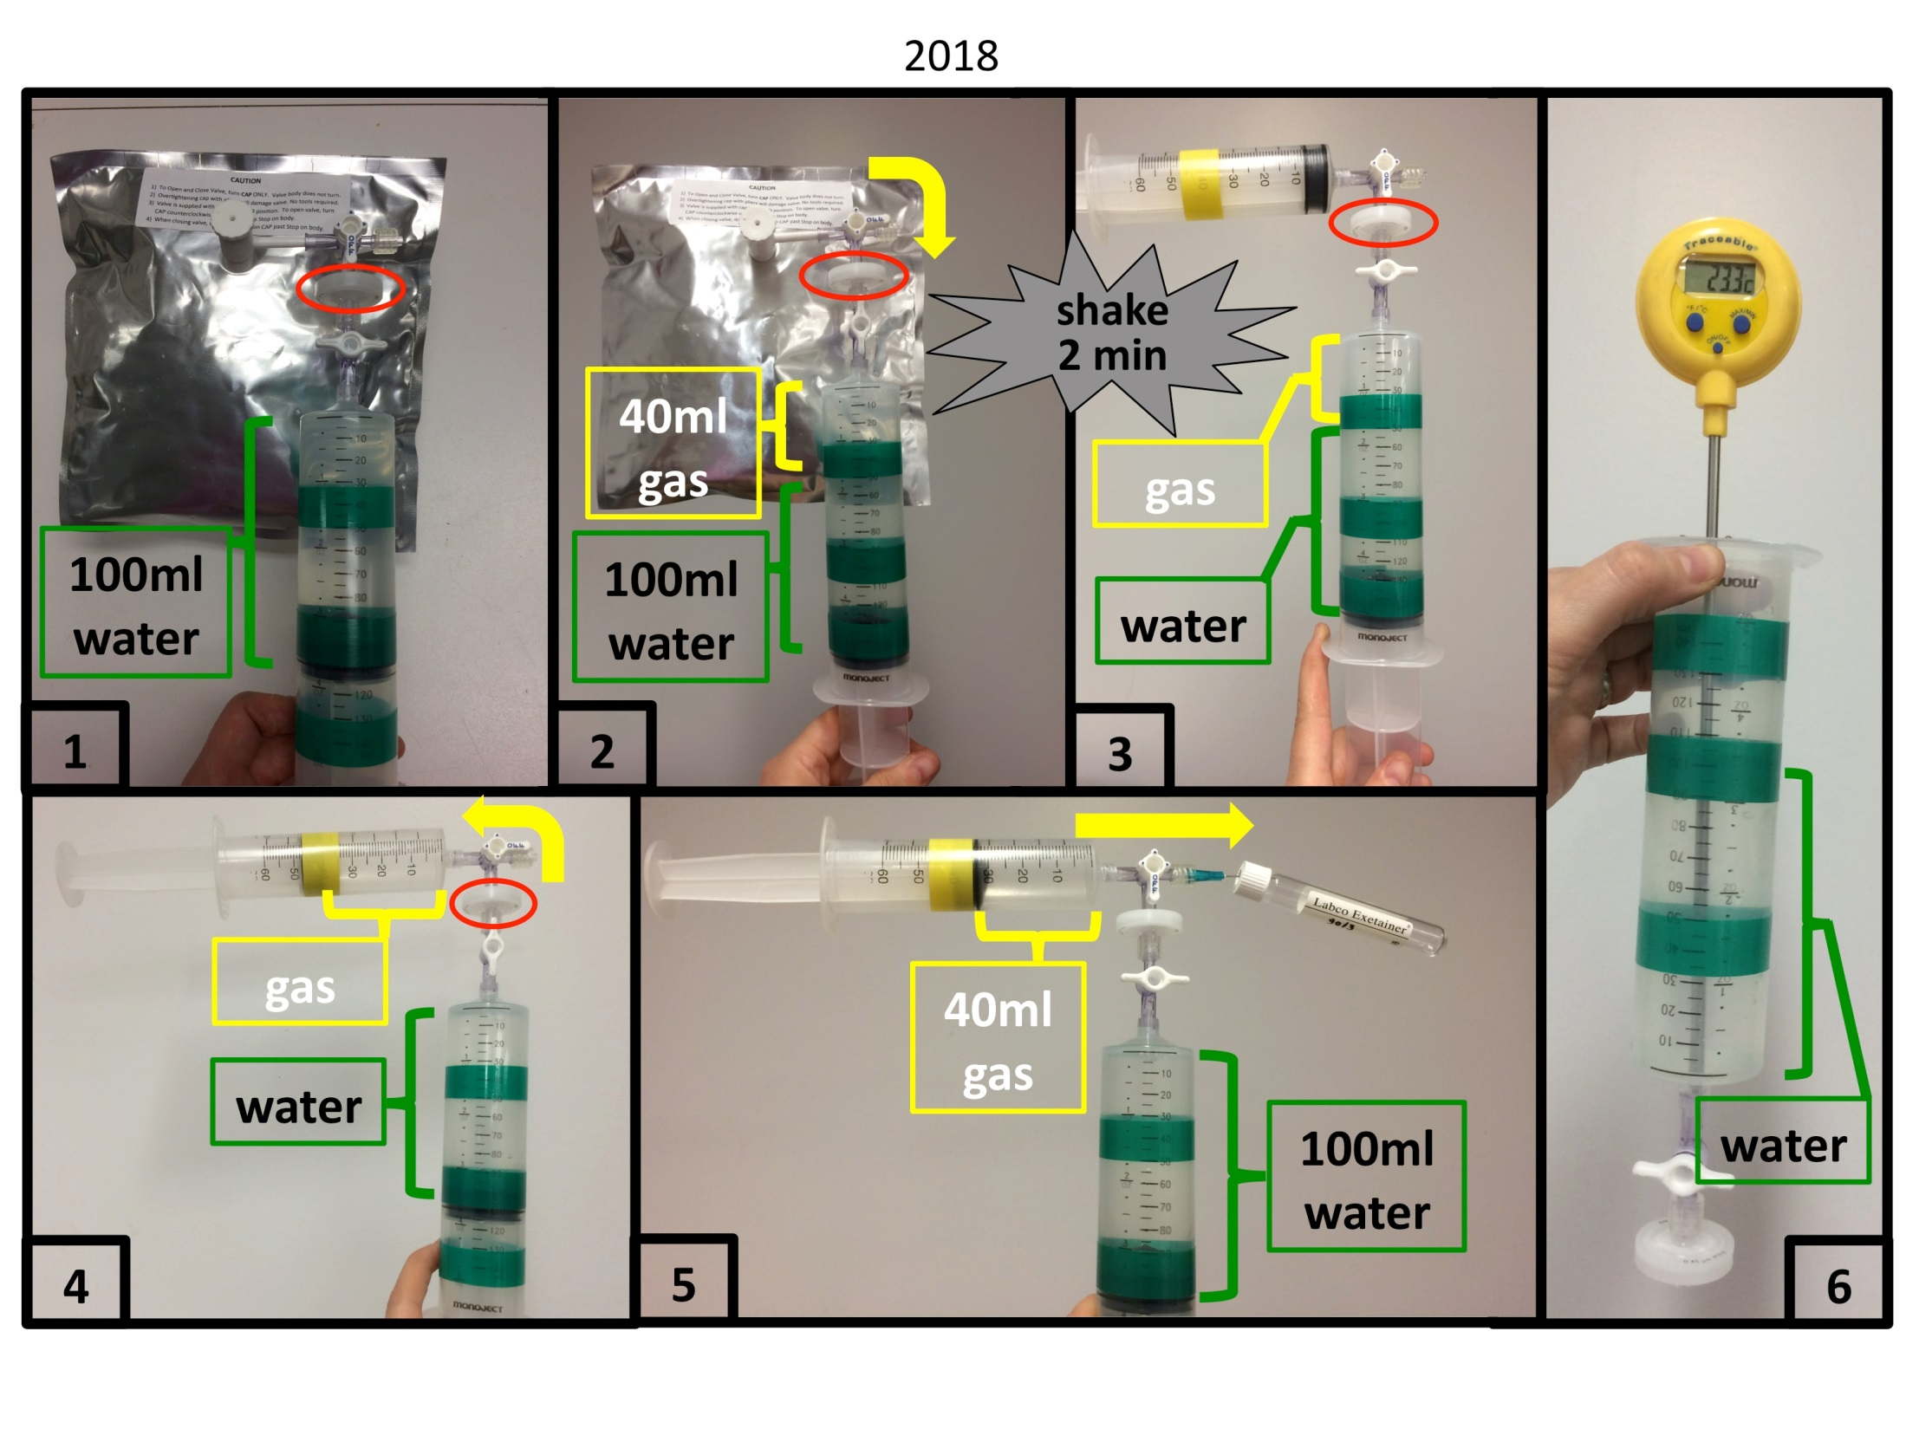
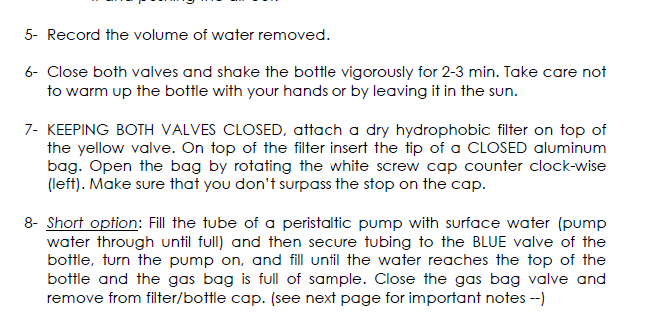
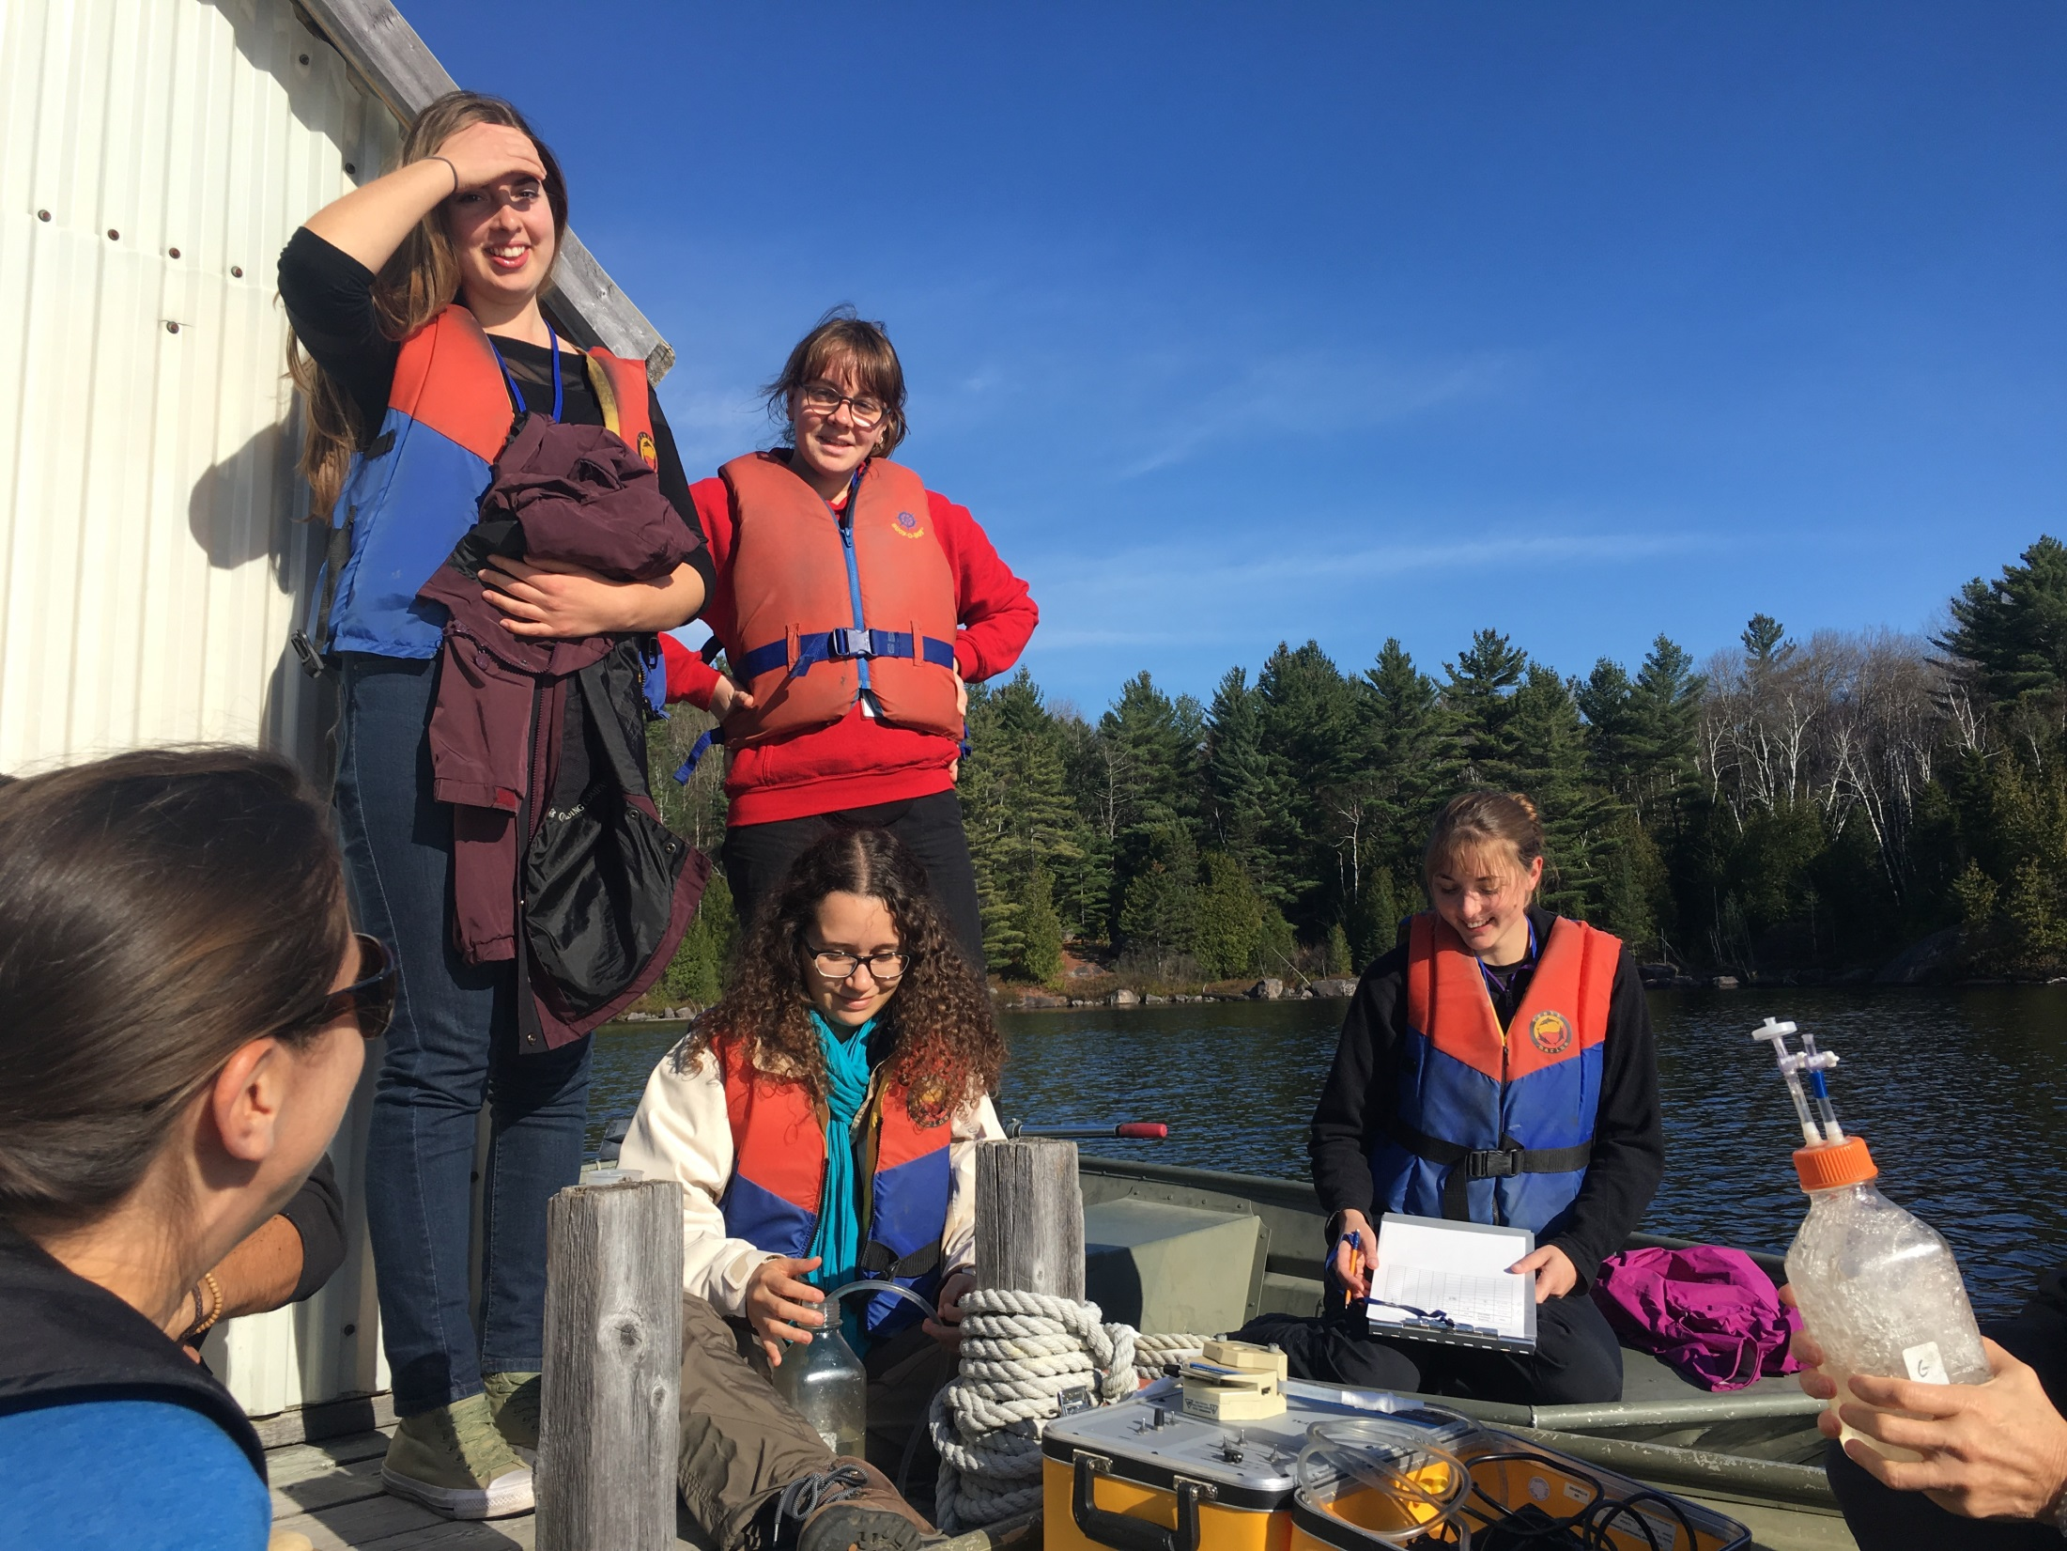
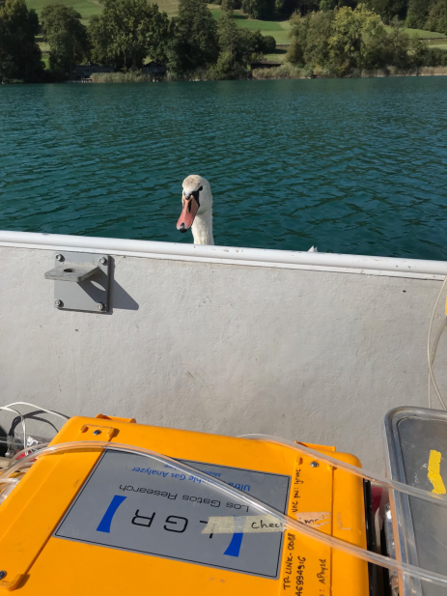
Gase

Slide 6
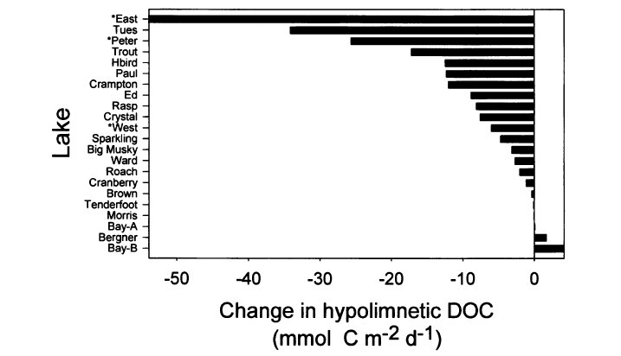
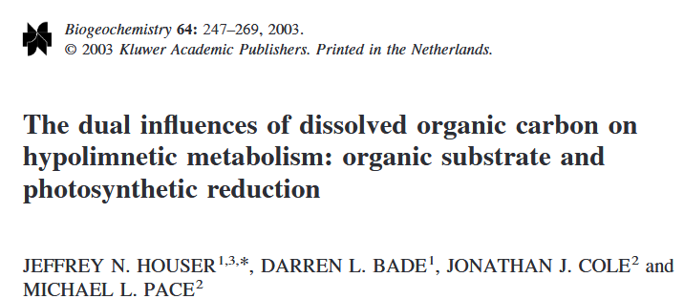
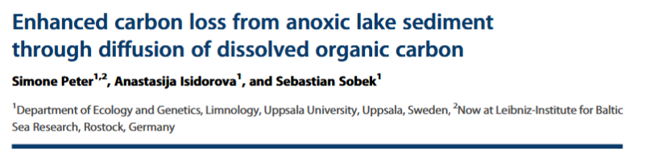
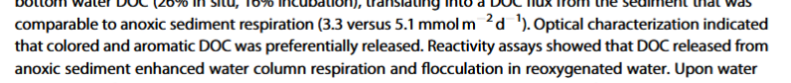
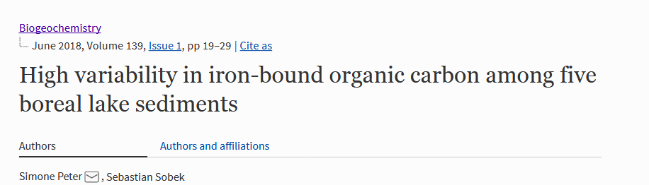
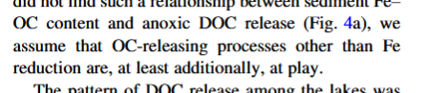
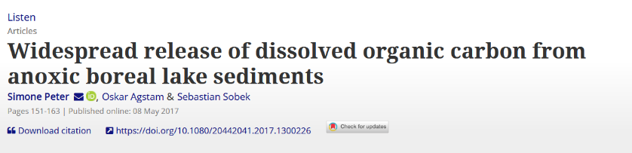
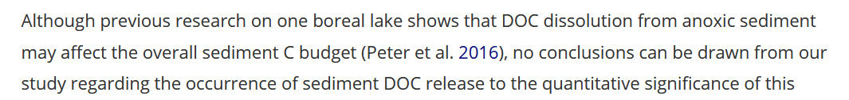
1
2

Slide 7
Kohlenstoff
DOC steigt mit Fe in anxischen Bedingungen,
und verändert seine chemische Zusammensetzung

Slide 8
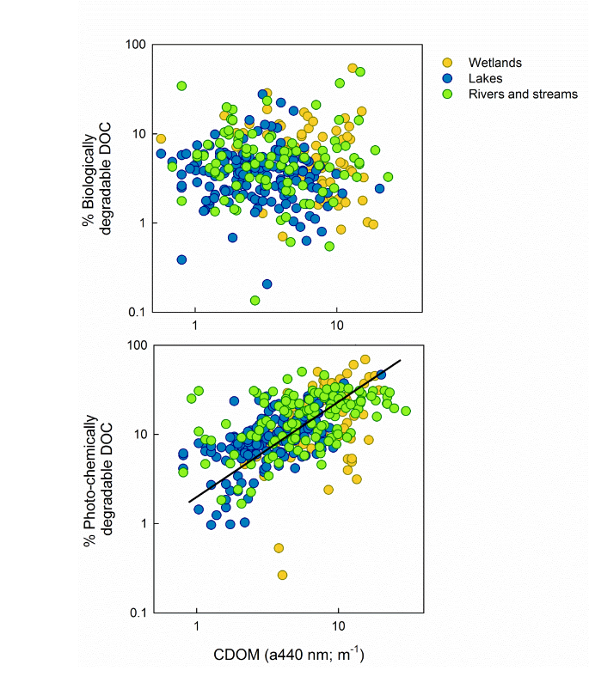
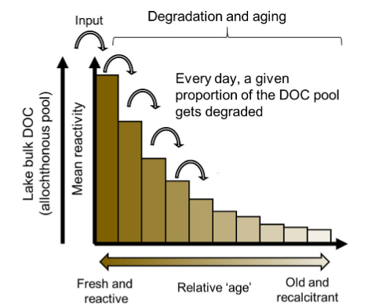
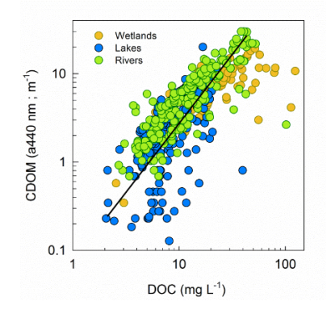
DOC Eigenschaften
This time
real bottles
Wie:
Inkubationen
Sediment-Porenwasser

Slide 9
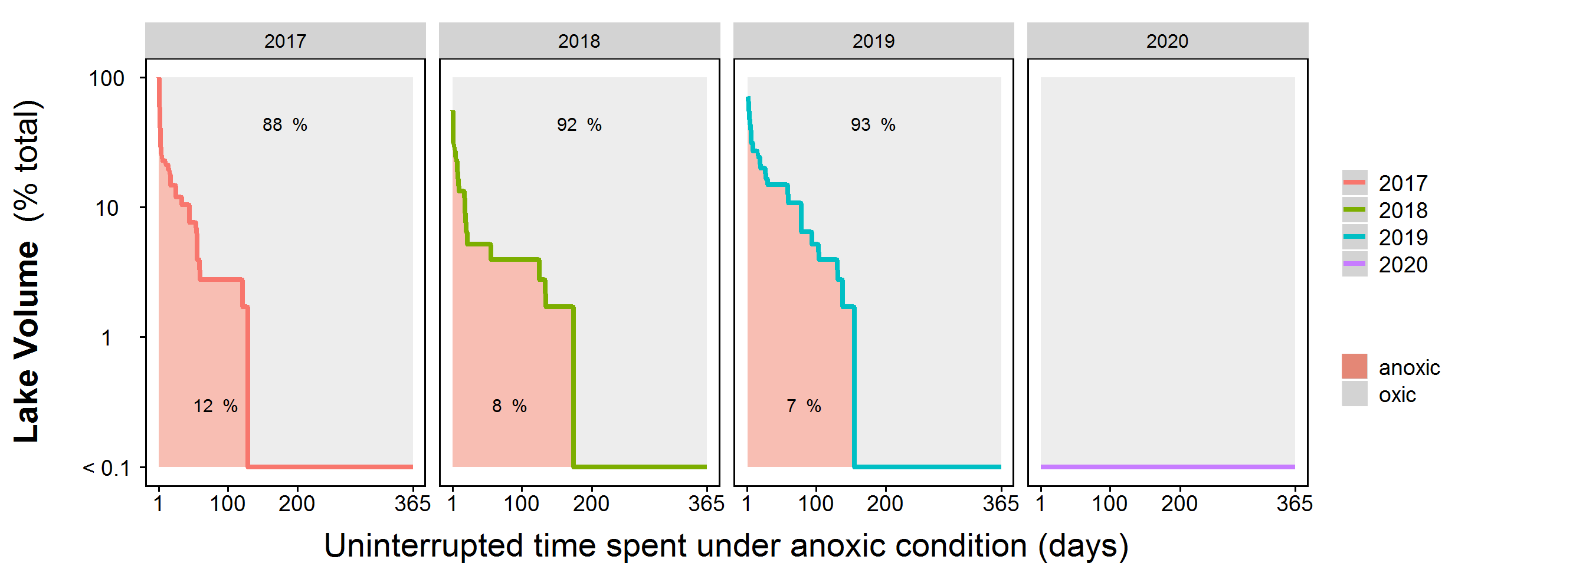
Sollte man zeitliche Regelmäßigkeiten finden, lassen diese sich gut skalieren…

Slide 11
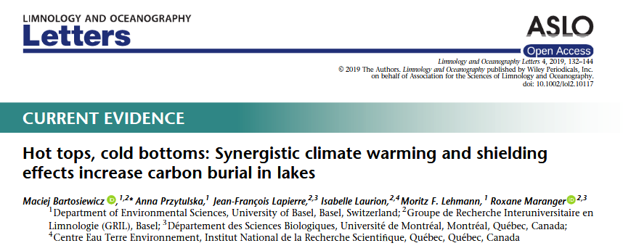
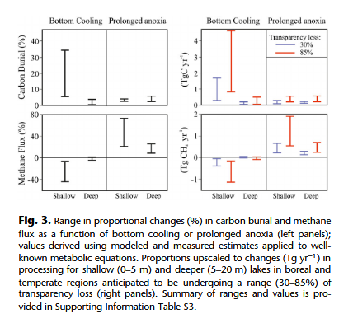
“three resulting mechanisms regulating temperature
and OM processing in lakes are:
enhanced surface warming that leads to a reduction in epilimnetic thickness,
Reduction of heat transfer toward bottom waters, and
more extended periods of stronger water column stratiﬁcation.

Slide 12
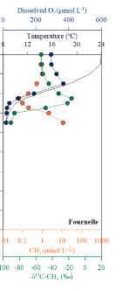
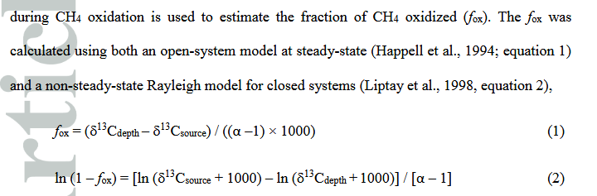

Methane oxidation
Thottathil et al 2018

Slide 13
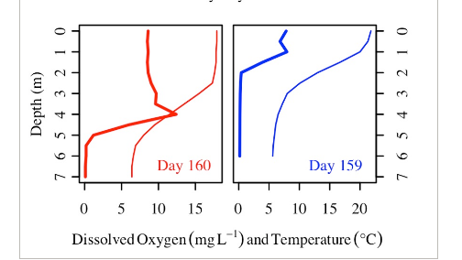
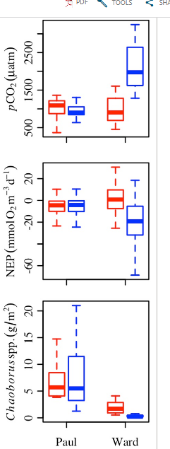
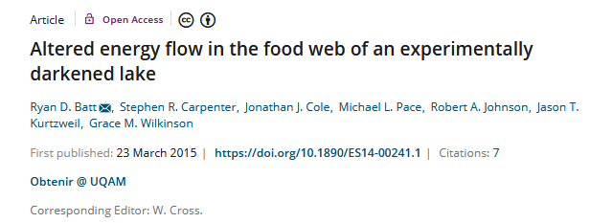
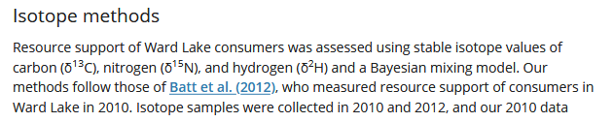
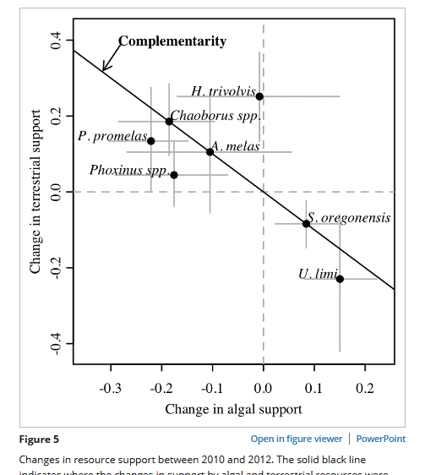
In Wirklichkeit: anoxia studie!
Thus ongoing effort is needed to understand other drivers of temporal change in resource support, and how resource support changes over longer time scales. Our study challenges a perspective that holds resources as unimportant if they currently support a small fraction of consumer biomass, and embraces a view of such resources serving food webs as insurance that may mitigate the adverse effects of constricted energy pathways.
Therefore, our results and those of previous studies suggest that zooplankton may become increasingly allochthonous as phytoplankton become less available, but taxon‐specific feeding habits may impose a limit on the extent of change.

Slide 14
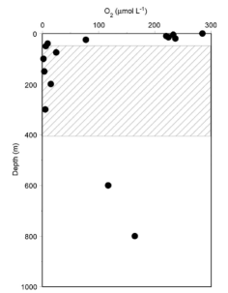
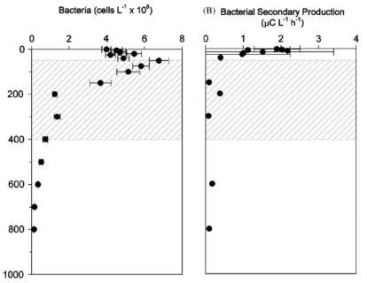
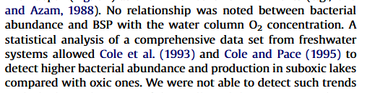
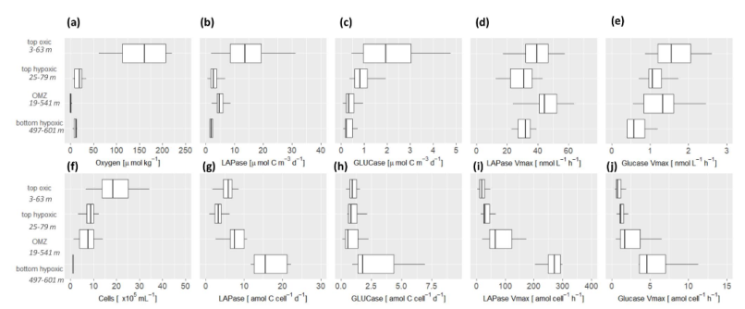
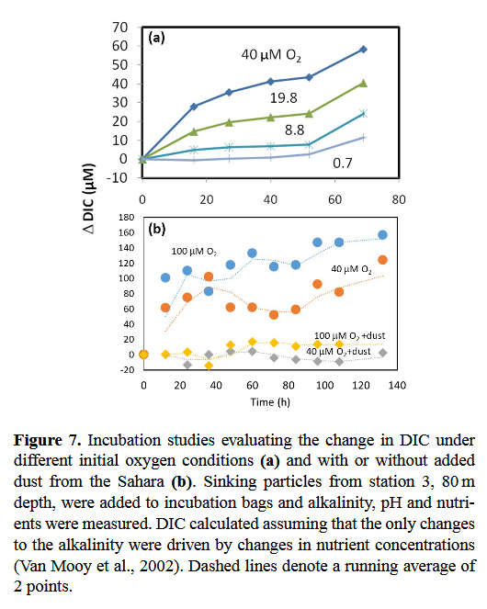
Some anoxic prejudice
or, “why do we care about it”
Pantoja 2009
low cell number
low microbial activity
Maßmig 2019
no oxygen, no OM-degrading enzymes
enzym. bulk activity:
similar
per-cell:
much greater (in anoxia)
“While the bacterial community composition in the hypolimnion diverged from the epilimnion community during the summer stratification, it became more similar to the community composition in the sediment, especially in the fall. “ Diao 2017
all anaerobic activity is in the sediments
respiration is thermodynamically
limited without oxygen
Keil 2015

Slide 15
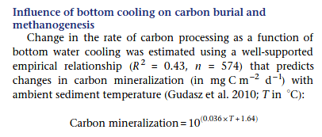
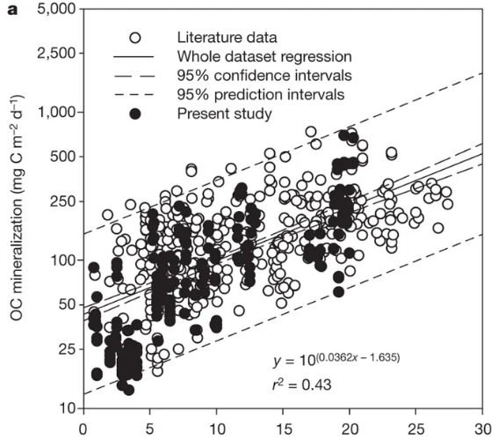
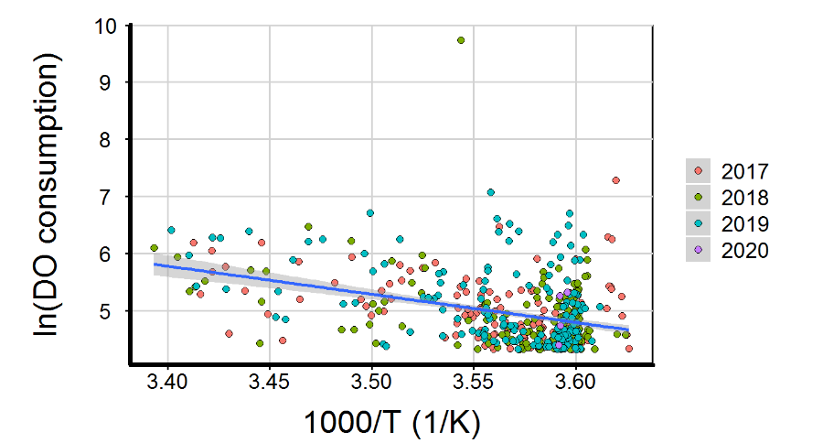
19°C
4°C

